Slide 1
On a trip
17. Modals

Slide 2

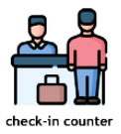

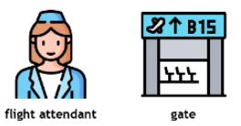


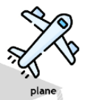
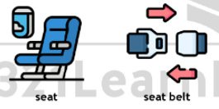
The airport
What happens in an airport?
What airline do you use?
What can do you in the airport?
What is forbidden in the airport?
Notes:
https://1.bp.blogspot.com/-oUPWiXdigYw/YDq2IFnRywI/AAAAAAABQiM/omgdOdD08DoBfmCX6-_TZMv0LMhITu2SACLcBGAsYHQ/s1755/vocabulary_at_the_airport_intermediate_b1__v2__321LearnEnglish_com_page-0001.jpg

Slide 3
Can, could, be able to
Modal | Function | Example
Can | ability, polite request, permission, possibility / impossibility | You can choose your seat.
Could |  | You could bring one bag for free.
Be able to * |  | You are able to check in online.
Notes:
Could is more formal than can
Be able to is a semi modal

Slide 4
Choose the correct one
The plane only takes off in an hour. We were able to / could have a cup of coffee now.
Please, could you help / will you be able to help me zip up my suitcase?
“Look Daddy, I’m strong! I is able to pick up / can pick up the suitcase by myself!”
“Is Betty able to carry / Could Betty carry such a heavy suitcase?” “Yes, she is.”
“Was I able to move / Can I move my seat back now?” “Yes, you can. We took off ten minutes ago.”
We thought we had plenty of time to get to the airport, but we were wrong. We aren’t able to get / weren’t able to get there in time.
Can you hold / Were you able to hold the boarding passes for a minute, please? I need to get something out of my bag.
We both have window seats. I’m afraid we will be able to sit / won’t be able to sit together on the plane.
Although I asked for a window seat, the flight attendant couldn’t give / can give me one. I had to sit near the aisle.
That’s odd. These sunglasses look just like mine, but they can’t belong / could belong to me. I put my sunglasses in my carry-on bag.
Notes:
1. could have
2. could you help
3. can pick up
4. Is Betty able to carry
5. Can I move
6. weren’t able to get
7. Can you hold
8. won’t be able to sit
9. couldn’t give
10. can’t belong

Slide 5
Modals
Modal | Function | Example
May | possibility, polite request | You may go.
Might |  | You might need a new battery.

Slide 6
Usage in conditional
We can use may, might, can, could, must, and mustn’t in the result clause of conditional sentences instead of will.
If I change the tire quickly, I can get to the airport by 2:00
If I rent a car, I could drive to the city
If you change the tire quickly, you may get to the airport on time
If you don’t change the tire quickly, you might miss your flight

Slide 7
Complete the sentences
If I can find a good flight deal, I may ________.
She might catch her flight if ________.
The flight may be delayed if ________.
The airline may give you snacks if ________.
If you travel outside the country, you might ________.
If I want to go on vacations, I may ________.
You might get an upgrade if ________.
The flight attendant might charge you if ________.
If you oversleep you may ________.
We may need to arrive earlier if ________.

Slide 8
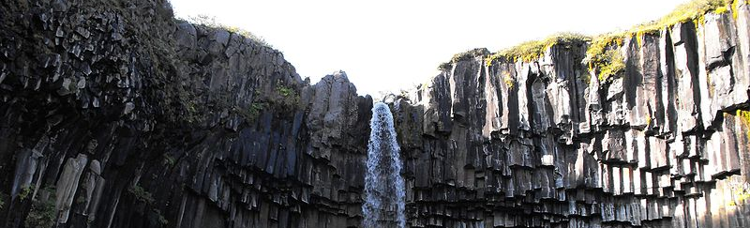
Talk about a trip destination
Choose a place you may visit
Tell us what you may see, and what activities you can do there
Example:
I may visit Iceland next year
In Iceland you can eat fermented shark
You could spend a whole day in the Blue Lagoon
You may see some Game of Thrones locations
Notes:
https://commons.wikimedia.org/wiki/File:Svartifoss,_the_waterfall_between_basalt_columns_-_Iceland_-_panoramio.jpg

